Slide 1


Binary Search Tree Data Structures and Algorithms
Cindy Hapsari / 2215101032

Slide 2


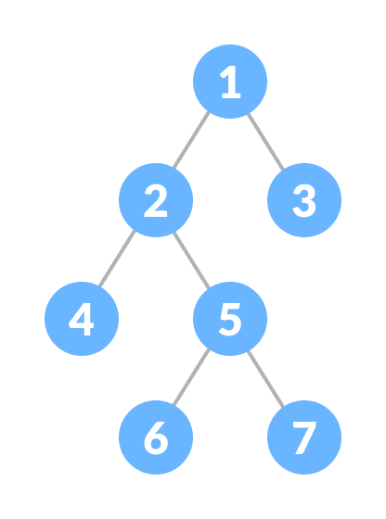
Binary Tree
Binary Tree A full Binary tree is a special type of binary tree in which every parent node/internal node has either two or no children.
Binary Tree have Parent, Sibling, Child, Root and Leaf. From the picture we see in here, [1] can called as Parent of [2] and [3]. Another example for [4] as child of [2] and sibling of [5].
[6] and [7] can called as leaf and [1] as root.
Types of Binary:
Unordered Binary Tree: does not follow any ordering mechanism.
Ordered Binary Tree: in an ordered binary tree, the left child node will always be less then its parent, and the right child node will always be greater than its parent.

Slide 3
Binary Search
Binary Search is an implementation method for several programming languages in searching for data in array element positions that have been arranged using Iterative and Recursive methods.
In Binary Search, always look for 'in the middle' of an existing array position. Unlike arrays, linked lists do not have a fixed size, and nodes can be dynamically added or removed
Operations:
Insertion: To insert a new node into a linked list
Deletion: To delete a node from a linked list
Searching: To search for a specific value in a linked list
Traversing: To traverse a linked list
Representation:
Array : limited elements on the binary tree
Linked List : unlimited elements on the binary tree

Slide 4
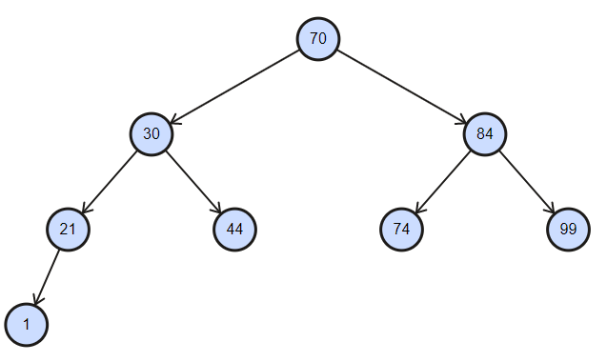
[Task] Binary Search Tree
My NIM is 2215101032 and my birth date is 06 August 2004. So, the result :
2215101032 x 6 x 8 x 2004
= 213074998470144
Then separate it in 2 pair numbers.
21 – 30 – 74 – 99 – 84 – 70 – 1 – 44
And after that, we need to arrange it into binary tree

Slide 5
[Task] Binary Search Tree
Pre-Order Preorder traversal making an order from root into left side (small nodes) and start to getting to right side (bigger nodes). We will have an order that from middle, then smallest nodes and go into right-left had a bigger nodes.
70, 30, 21, 1, 44, 84, 74, 99
In-Order We will have a normal arranged integer numbers.
1, 21, 30, 44, 70, 74, 84, 99
Post-Order we will find that we will start from leafs/children are smaller and the will go into the parent of leaf. After that, we won’t go into the root first. But we will go into another leaf and make it an order again. In last of order, we get root nodes.
1, 21, 44, 30, 74, 99, 84, 70

Slide 6
[Task] Array Representation
Key Concept:
if parent stored in index k, then
its left child is located in index 2k+1
its right child is located in index 2k+2
Index 0 is the root
Index | 0 | 1 | 2 | 3 | 4 | 5 | 6 | 7
value | 70 | 30 | 84 | 21 | 44 | 74 | 99 | 1

Slide 7
[Task] Binary Search Tree’s Code C++
https://drive.google.com/drive/folders/13R3mSM0VS5elSz9SrjJqSOUwvZpVyd_T?usp=drive_link
The task on this link. Thank you

